Slide 1
San Francisco 2018 Crime Analysis and Insights
Presented by: Maaz Ansari, Haoxuan Chen, Carolina Cortes-Rivera & Diomarys Hernandez

Slide 2





























Agenda
Objective
Background Information
Data & Visualizations
Recap of findings
Recommendations
Questions & Comments
References

Slide 3


Objective
The city of San Francisco would like us to complete an analysis of crime patterns in the city. They received extra funding this year and want us to figure out the best ways they should spend this money to understand & reduce crime in the most vulnerable neighborhoods.

Slide 4
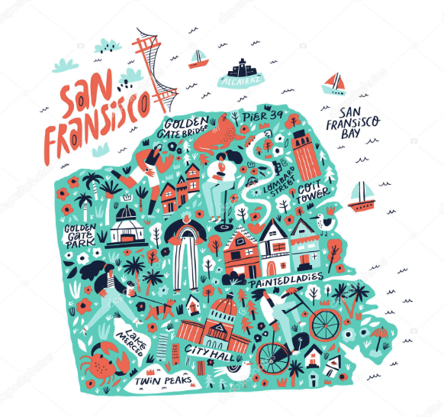
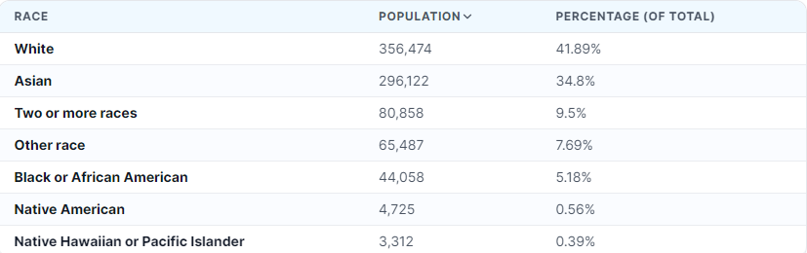
Background Information
San Francisco is a lively city, famous for the Golden Gate Bridge, steep hills, and its diverse, dynamic neighborhoods. It's a mix of tech innovation, rich culture, and progressive values, with a charm that sets it apart on the California coast.

Slide 5
Data and Visualizations

Slide 6
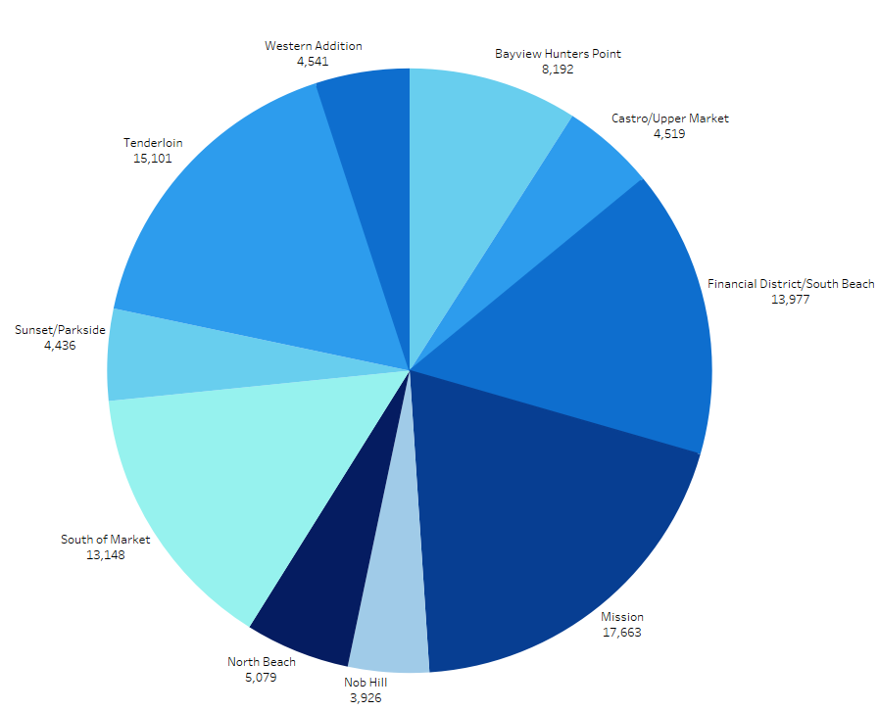
Top 10 Neighborhoods With the Most Crime
TOP 5
Mission
Tenderloin
Financial District/South Beach
South of Market
Bayview Hunters Point
Lowest
Nob Hill
Sunset/Parkside

Slide 7
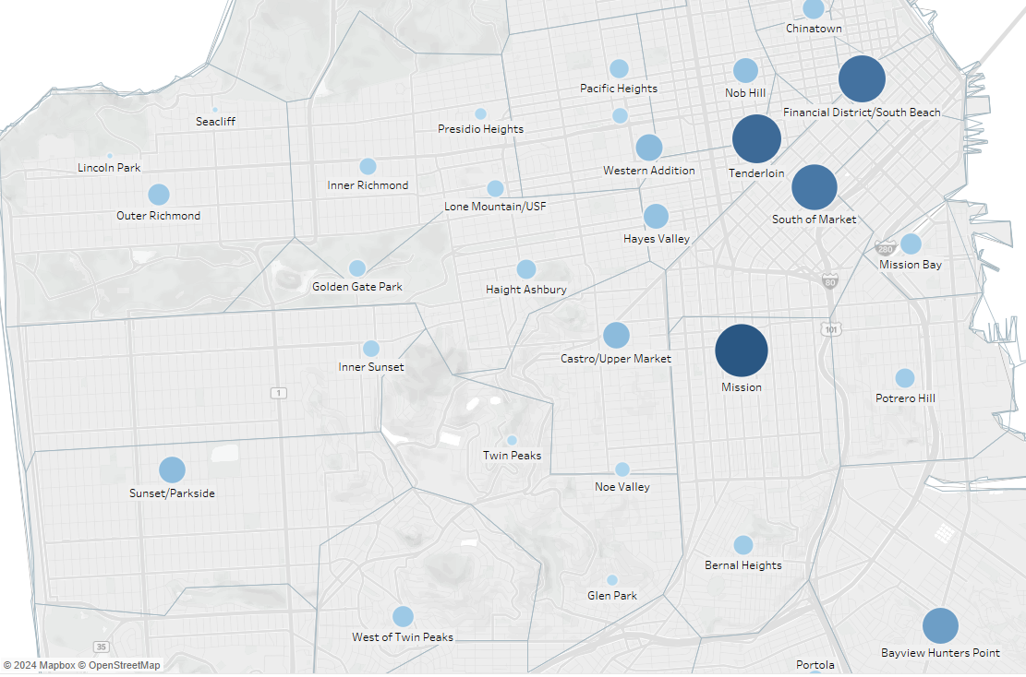
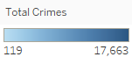
What Neighborhoods Have the Most Crimes?
Cities with dense populations usually have more crime due to more social interactions.
Neighborhoods with middle-class families, suburban areas, and luxury hotels usually have lower crime rates, likely because they offer greater stability and better security.

Slide 8
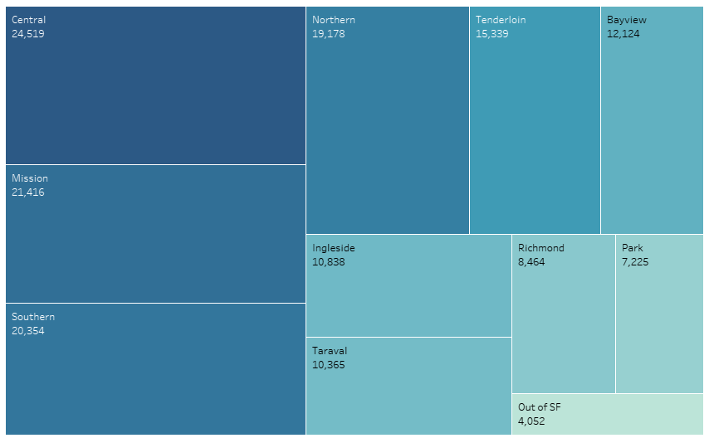
Which Police District deals with the most Crime?
Police districts that have reported the most crimes are usually stationed near the Civic Center.

Slide 9
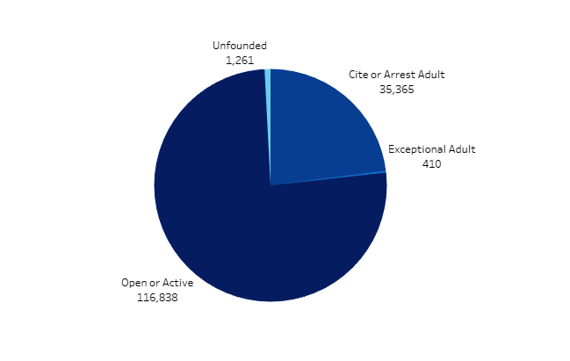
What are The Current Status of The Active Crimes?
There are way more active cases then there are cited

Slide 10
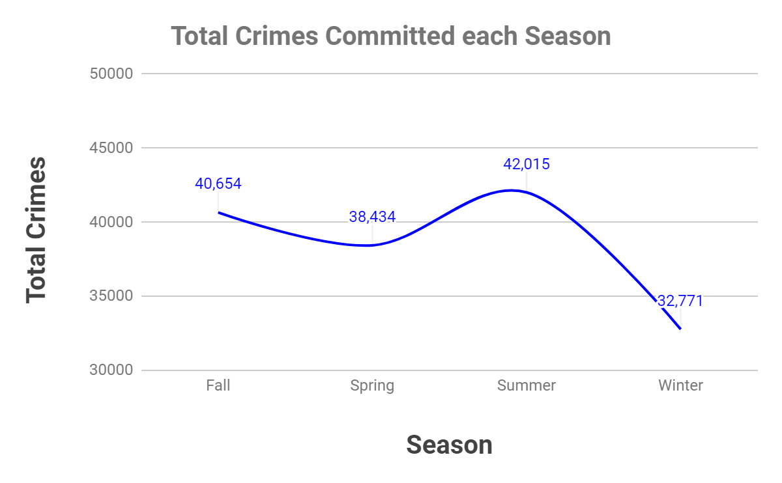
Which season does Crime occur the most often?
Crime peaks in the summertime and decreases in the winter

Slide 11
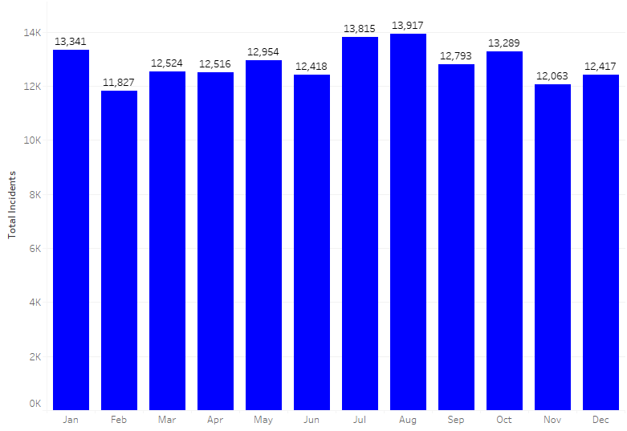
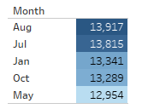
Which Month had the highest Crimes Committed
Total Crimes Committed by Months
Month

Slide 12
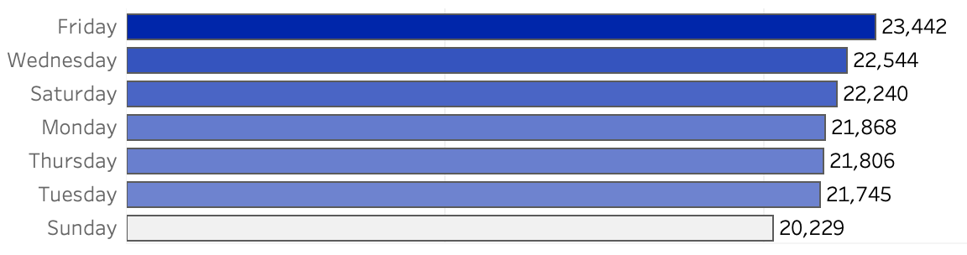
What days are we seeing the most crimes?
Reported Crime Rates Throughout the Week
On average, most Crimes occur on Friday and the least amount of crimes are reported on Sunday

Slide 13
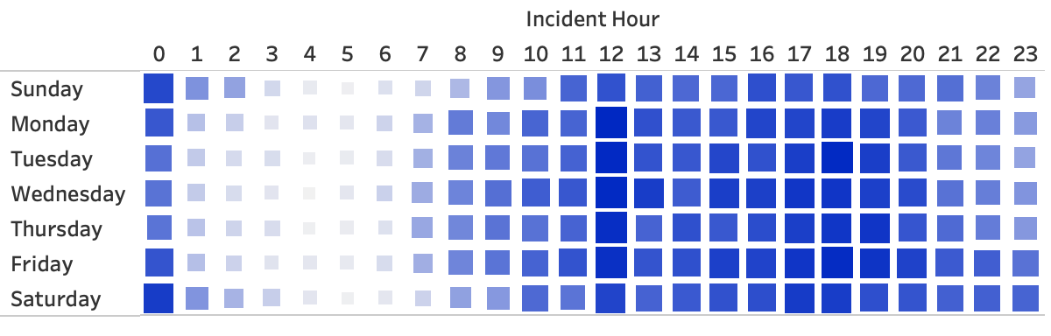
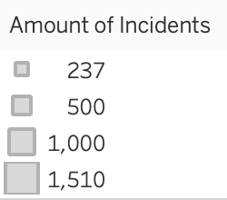
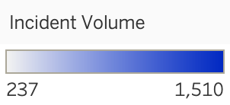
What times are we experiencing the most crime?
Crime Reports by Day and Hour
12pm-7pm have the highest concentration

Slide 14
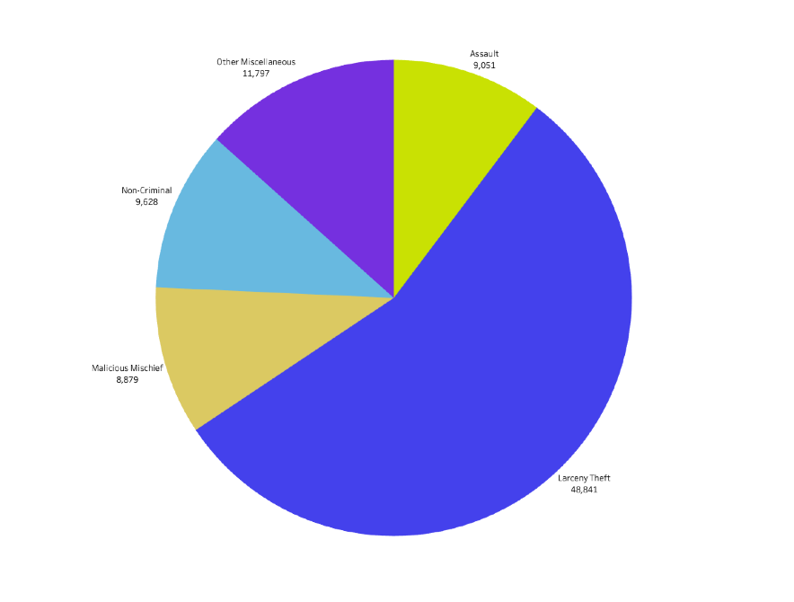
What are the top crimes?
The top crime is larceny theft, which points to a social-economic issue-this information is confirmed by the other categories in the data like crimes related to properties and vehicle thefts.
Salary disparity - Median Salary in 2018
Missions $96,677
Tenderloin $31,061
Bayview Hunters Point $63,470

Slide 15
Recap of findings
Crimes are occurring mostly during Summer and Fall
The neighborhoods with the most crimes are: Mission, Tenderloin, Financial District/South Beach, South of Market, and Bayview Hunters Point
Crimes are mostly happening during the hours of 12pm-7pm
The majority of the crimes are larceny theft

Slide 16
Recommendations
Enforce more law enforcement at certain times - conduct further analysis on current police presence in different neighborhoods.
Resolve active crimes
Focus on resolving heavily committed crimes
Funnel more resources into the neighborhoods/police districts with the most reported crime incidents
Conduct community outreach to understand what goes on during the hours of 12pm-7pm
Have more community activities during the early afternoon in these neighborhoods
Introduce more social service programs like housing assistance, education, and job training

Slide 17
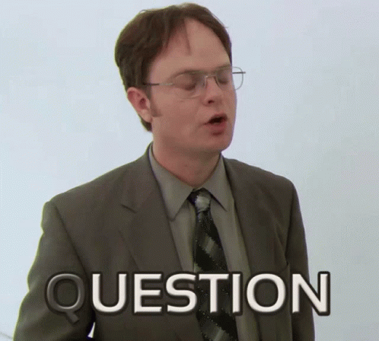

Questions and Comments

Slide 18
References
https://data.census.gov/profile/San_Francisco_city,_California?g=160XX00US0667000
https://data.sfgov.org/Public-Safety/Police-Department-Incident-Reports-2018-to-Present/wg3w-h783/data_preview
https://worldpopulationreview.com/us-cities/california/san-francisco

